Slide 1
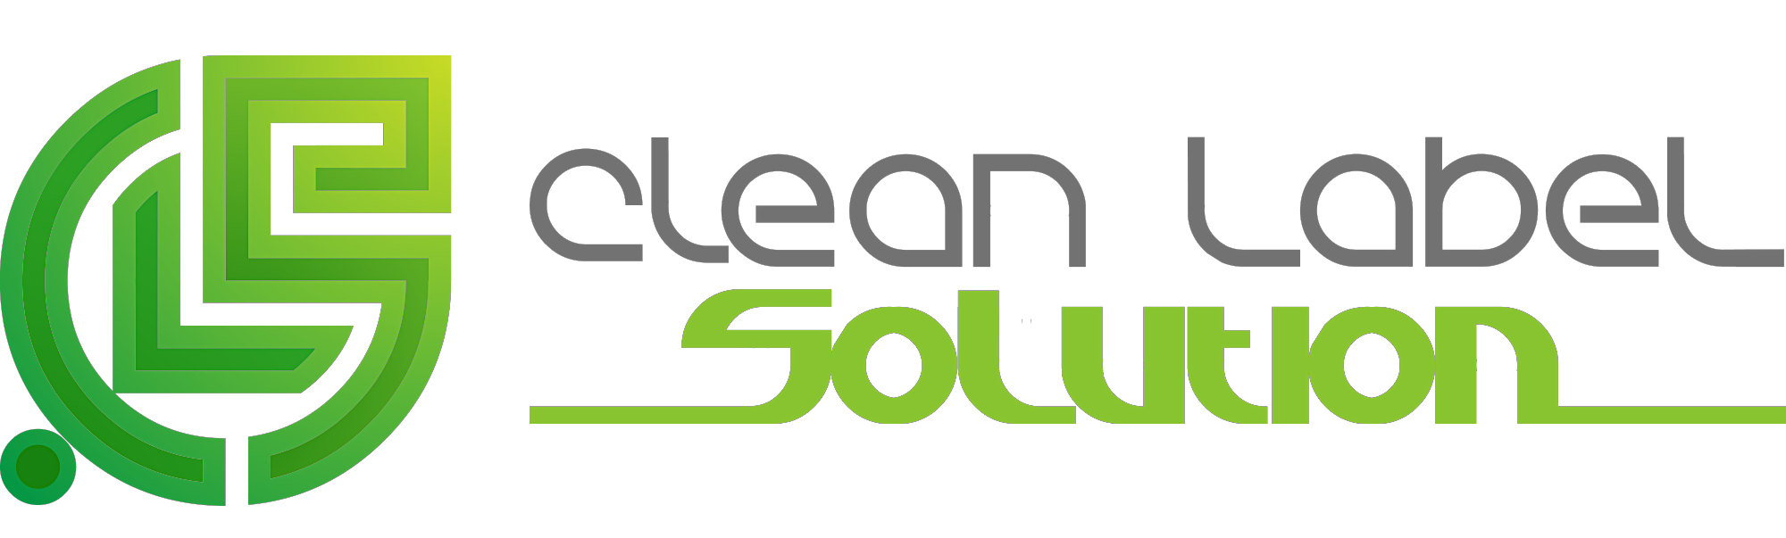
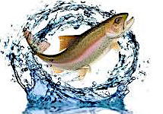
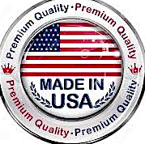
Victory fish feed
Clean Label Solution LLC
www.cleanlabelsolution.com
188 pleasant grove road, first floor, Ithaca, NY 14850, USA
+1 (607) 351-5301 mohammad.arshadi@cleanlabelsolution.com

Slide 2
Advantages of Victory fish feed vs. Fishmeal
The production process is environmentally and ecologically sustainable
Highly cost effective
All ingredients are natural, and feed grade
Provides the required balance of amino acids and other essential nutrients (e.g. fatty acids, macro and trace metals)
Improves fish gut microbiota, health, immunity and growth
Highly efficient protein digestion and amino acid absorption
www.cleanlabelsolution.com

Slide 3
Performance of a Ration Containing 10% Victory fish feed vs. Fishmeal on the body weight and protein level of Salmon
www.cleanlabelsolution.com

Slide 4
Performance of a ration containing Victory fish feed vs. Fishmeal on the immune system of Salmon
www.cleanlabelsolution.com

Slide 5
Cost Saving for Ration Containing 5% Victory fish feed vs. Fishmeal
Victory fish feed Pricing: $770/ton
Fishmeal Pricing: $1490/ton
Fishmeal replacement with Victory fish feed in Ration: 5%
Cost Saving for production of 1000 ton aquafeed: $40,000
Keep in mind:
Ration containing Victory fish feed has either the same or better performance than Fishmeal
www.cleanlabelsolution.com

Slide 6
Benefits of Victory fish feed
Improves the immune system of fish
Increases the protein level of fish
Same performance upon replacement with fishmeal
Highly reduces the ration cost
Why Victory fish feed?
www.cleanlabelsolution.com

